Slide 1
Virtual Router Redundancy Protocol and Hot Standby Router Protocol
Presented by
Md. Sazzad Hossain
ID: 15201445
Supervised By
Satyaki Das
Lecturer
University of liberal arts Bangladesh

Slide 2
Company Details
Company Name: ADN EduServices Ltd.
Add: Malancha Green
House#58, Road#3/A
Dhanmondi, Dhaka-1205
Bangladesh

Slide 3
Company Working Process
Our Company follow Agile-Scrum process.
Every development, requirement and solution come through collaboration self organizing cross-functional teams.
It promote a disciplined project management system.
What I have done since the last meeting.
Discuses
Issues that I have to solve.

Slide 4
Project: VRRP
Virtual router redundancy protocol
It provides fail-over/ redundancy for layer 3 based gateway devices
One Master rest of them are backup.
When Master gateway device in the network fail, the VRRP enable pre-configured backup devices take over its place within 1 sec and resume the network function.
It’s so fast that user don’t experience an disruption of network services
It can also works for load balancing.

Slide 5
VRRP
Its Open Standard Protocol. Multiple vendor supported protocol. Cisco and Juniper both can use it
It can use Physical and Virtual Address
Real IP address can be use as gateway.
Hello 1sec and Hold down timer 3sec.
By default Preempt is enable.
It is a network layer protocol

Slide 6
Tools: GNS-3
Graphical Network Simulator-3
First introduce in 2008
Its upgraded than packet tracer
It’s allow to design complex network topologies
Simulated topology can be connected to real world.
Other devices and vendors are also supported

Slide 7
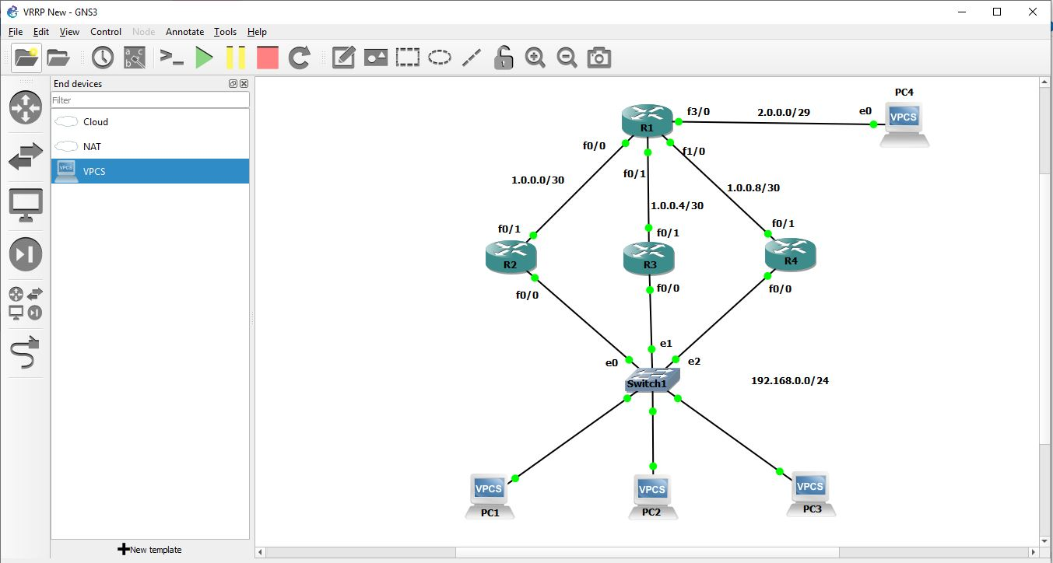
VRRP Tropology

Slide 8
IIG
International Internet gateway. are the internet data communications services for connecting with internet service providers in both domestic and international. IP Transit Service is to connect with multinational internet data by using network in Thailand as a hub.
The company aims to offer these services to both domestic and international service providers as well as mobile phone and broadband service providers.

Slide 9
Router
It is a networking device that forwards data packets between computer networks.
objective is to connect various network simultaneously
It is Layer-3 device

Slide 10
Switch
A network switch is networking hardware that connects devices on a computer network by using packet switching to receive and forward data to the destination device.
It’s main objective to connect various devices simultaneously.
Network switches operate at Layer 2

Slide 11
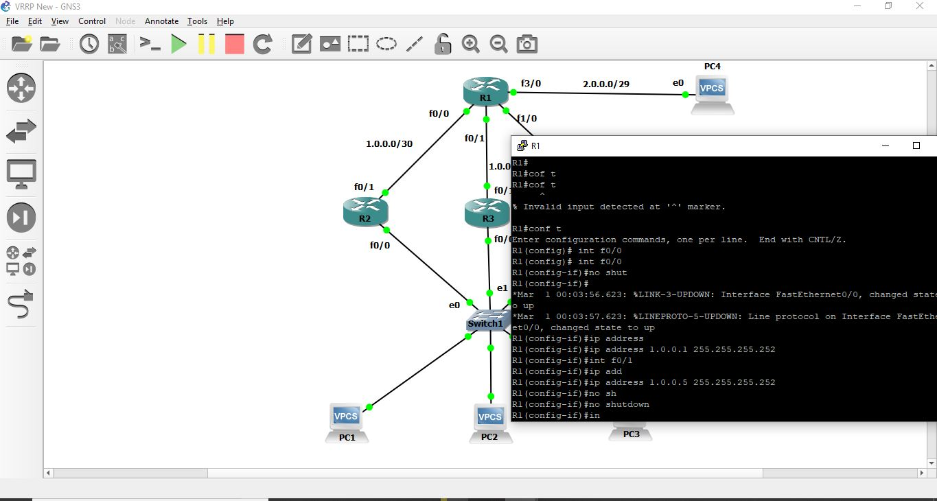
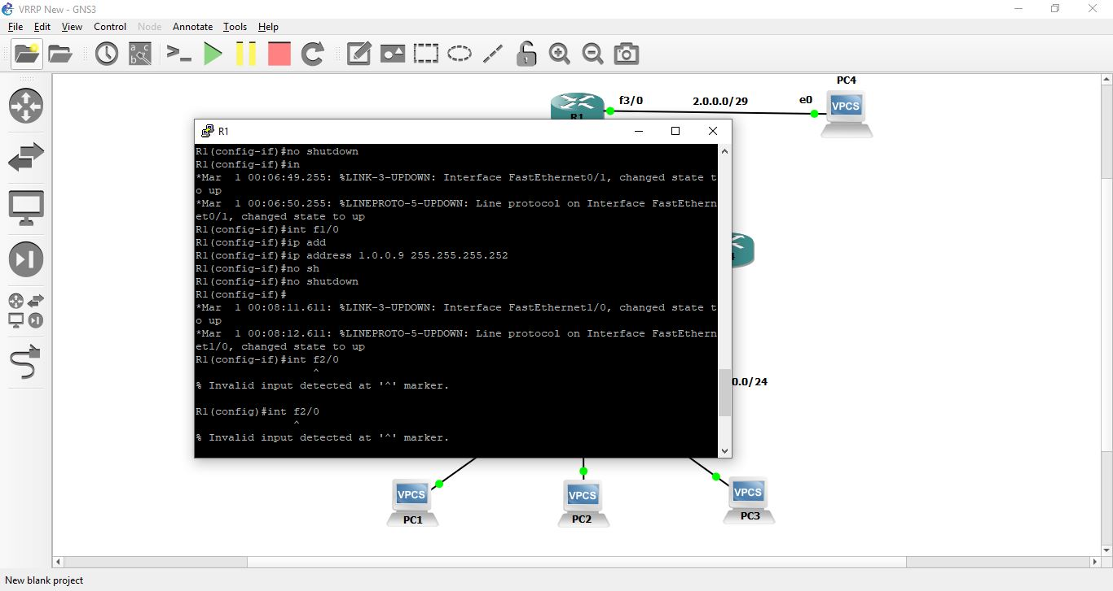
Configure

Slide 12
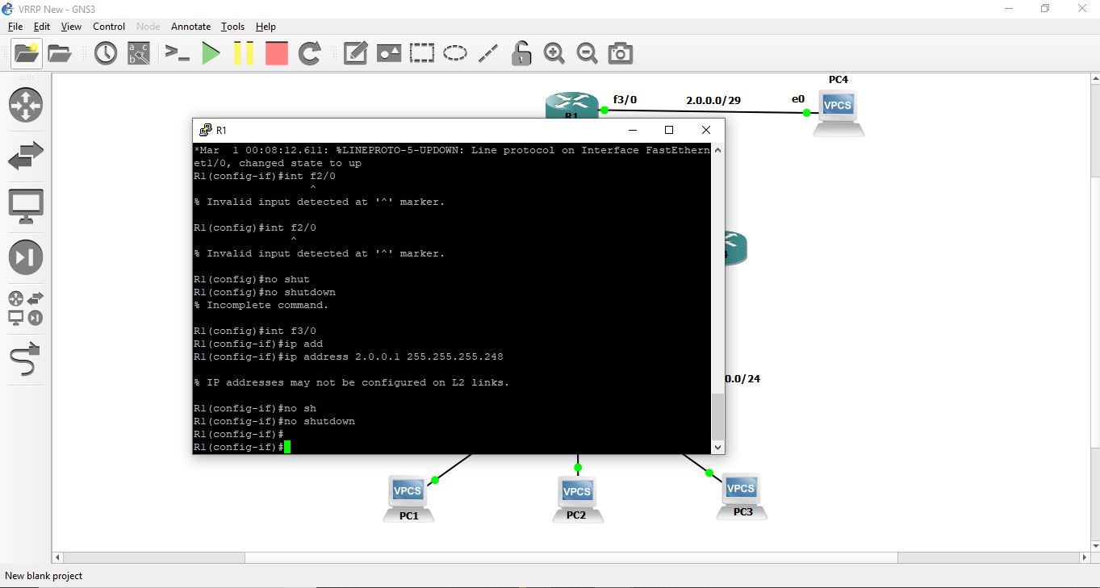
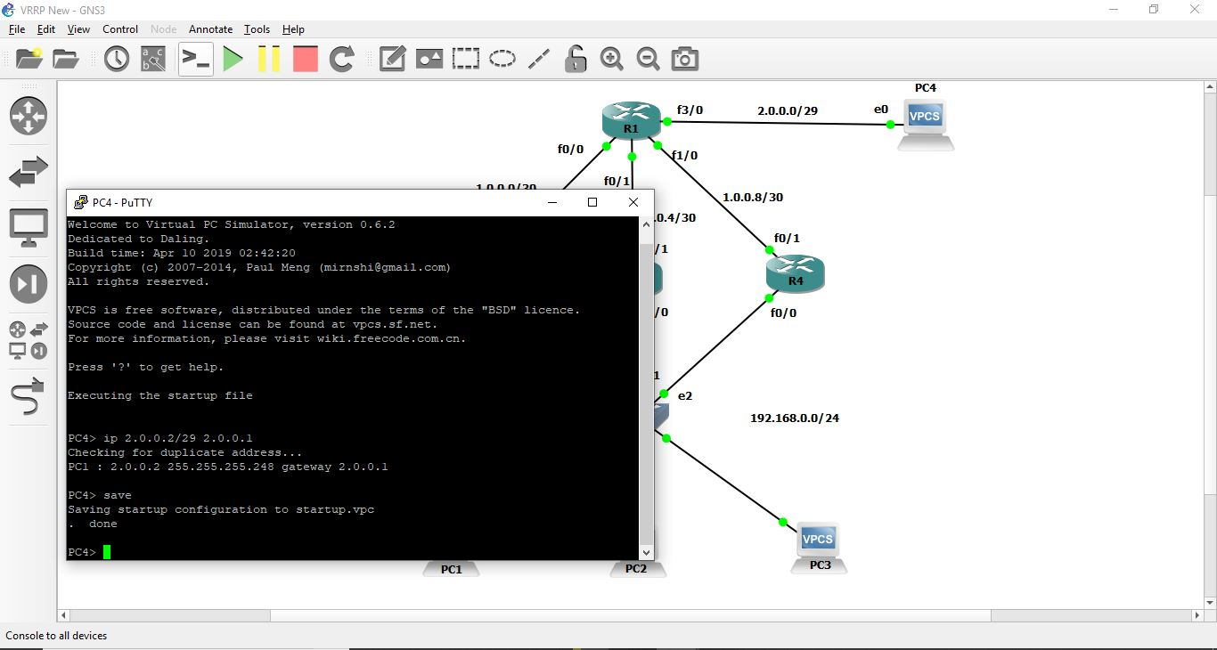

Slide 13
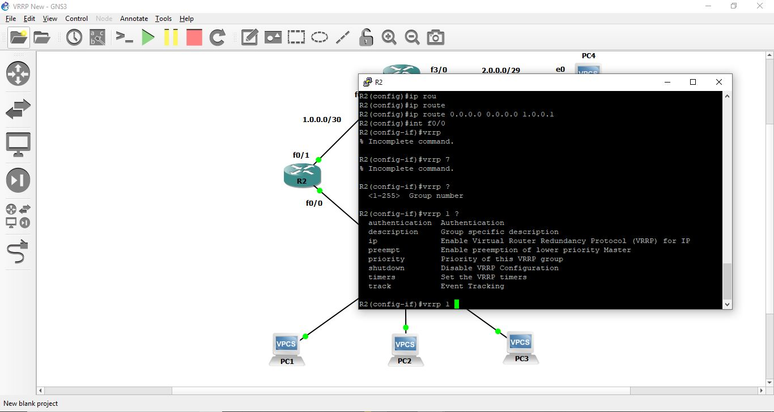
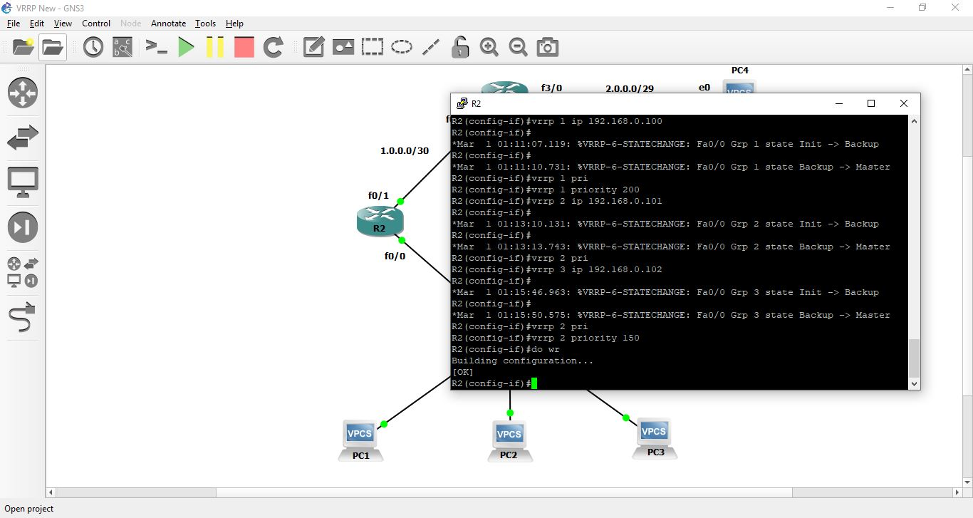
VRRP Enable

Slide 14
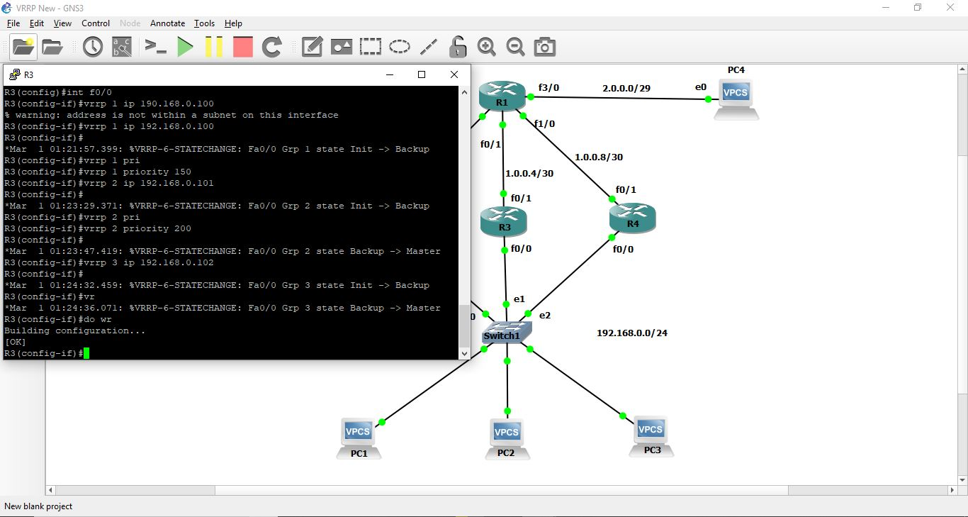
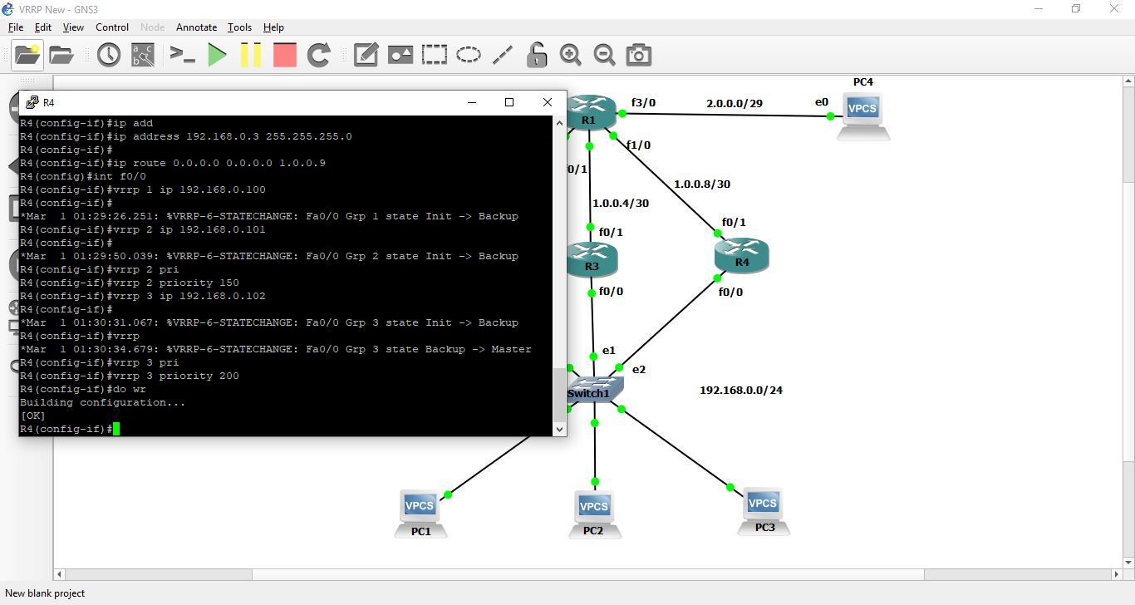
Priority set

Slide 15
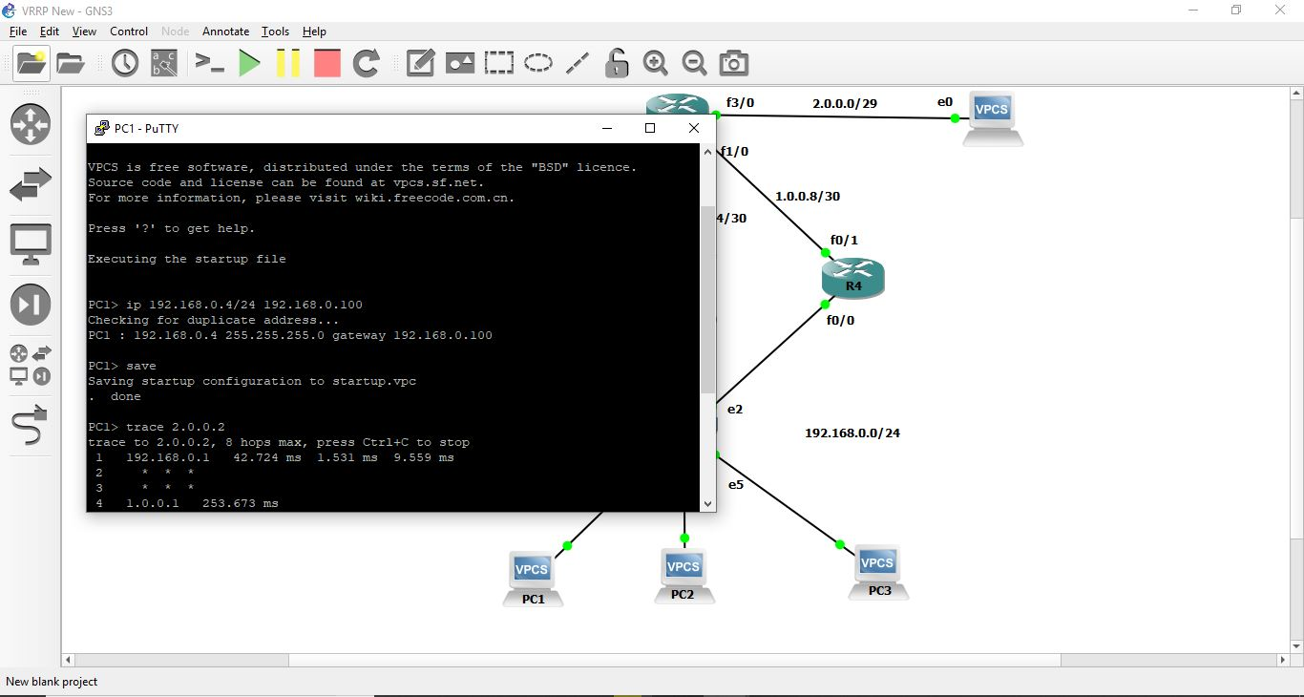
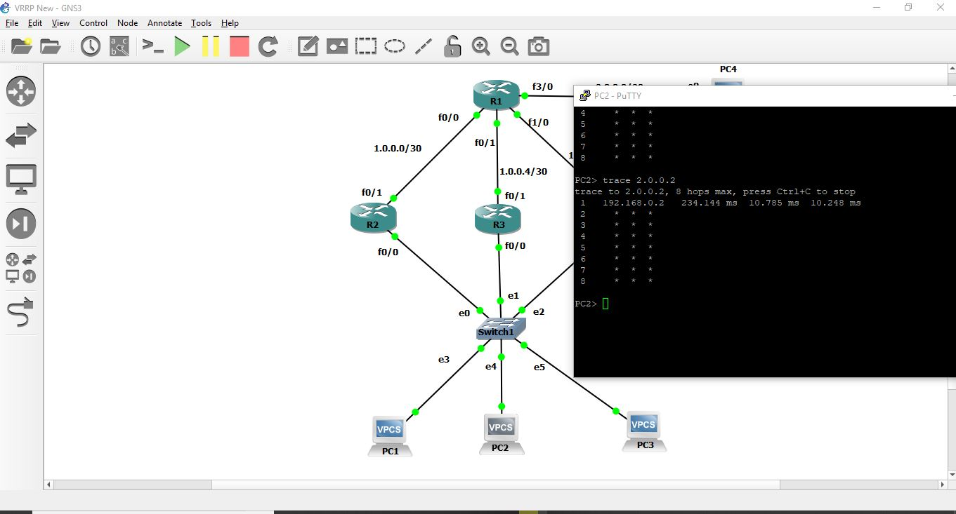
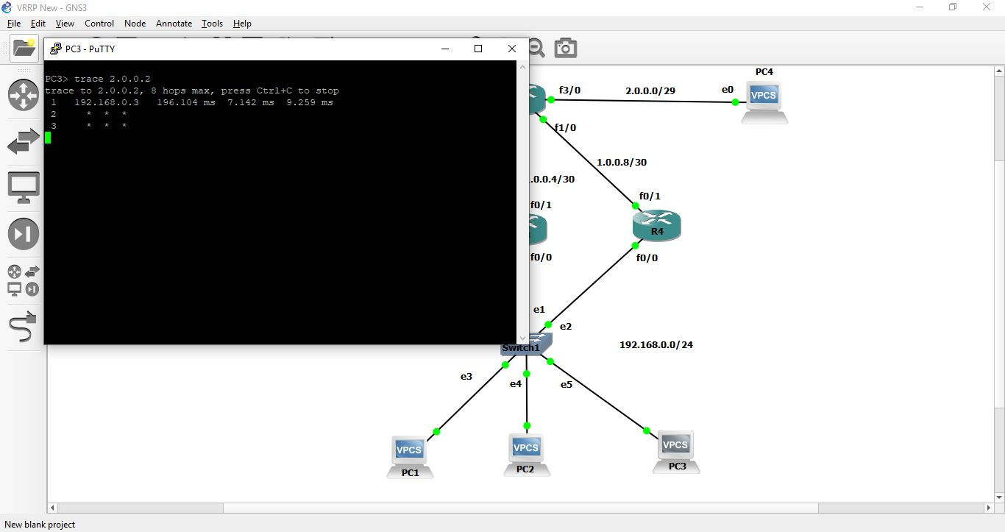
Trace

Slide 16
Project: HSRP
Hot Standby Router Protocol
HSRP also allows network hosts to look like they are using a single router and keep connected if the first hop router being used fails to respond.
The HSRP normally joins several routers together to create a single virtual server that client machines and networks use
There are 2 Version.
In version one there is 0- 255 grope and in version 2 this grope is between 0- 4095.

Slide 17
HSRP
Its Cisco proprietary protocol
1 Active, 1 standby rest of other are on listening mode
Use only virtual IP add as gateway
Hello 3sec and hold down timer 10sec
We have to preempt manually

Slide 18
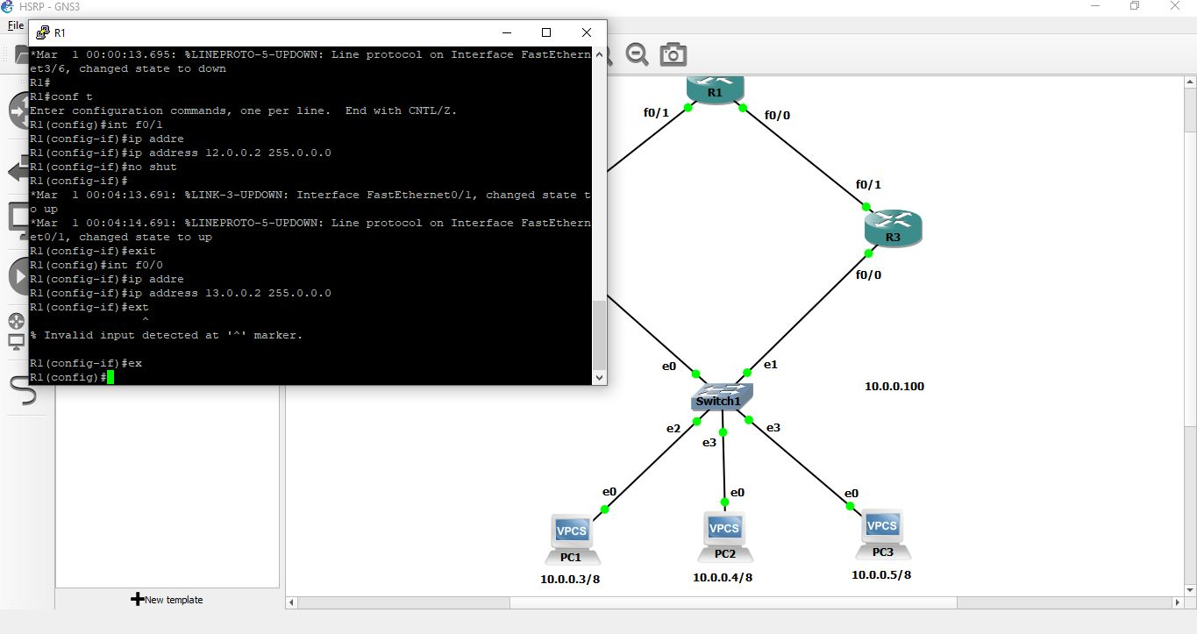
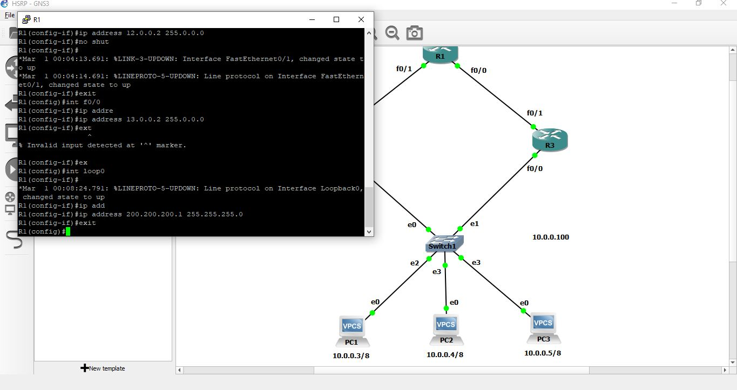

Slide 19
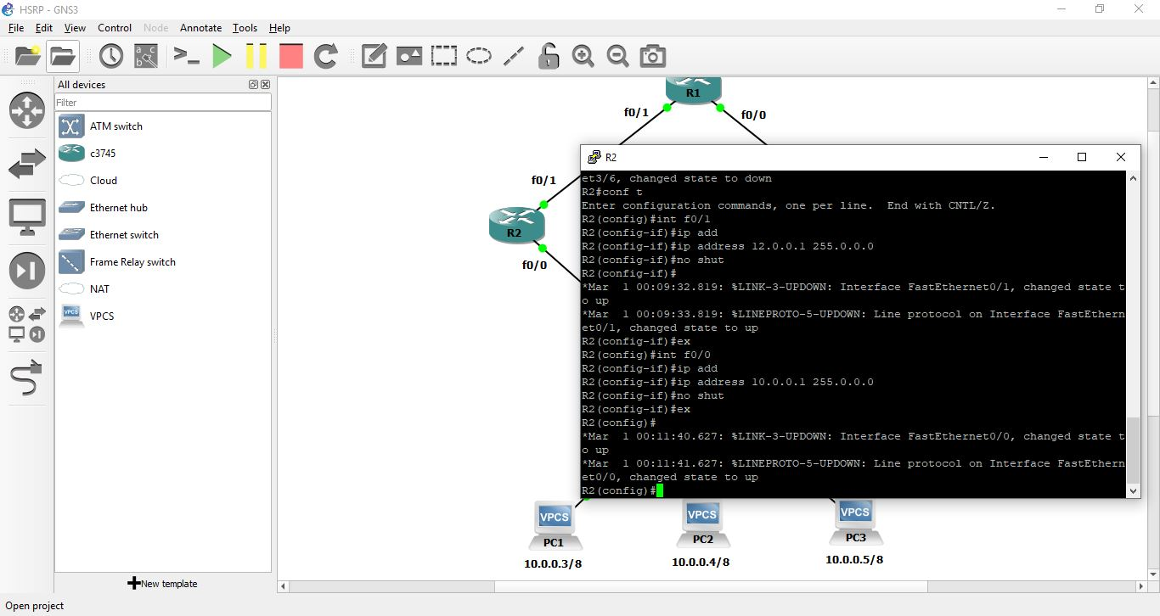
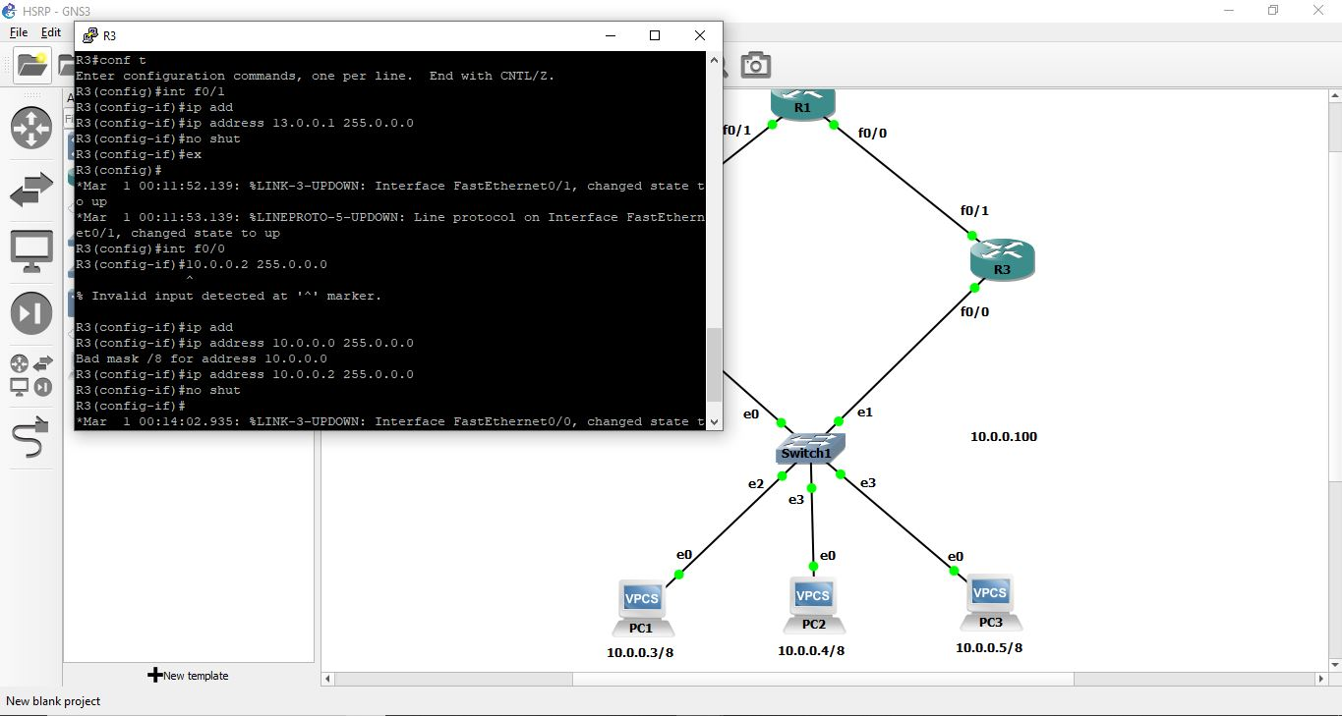

Slide 20
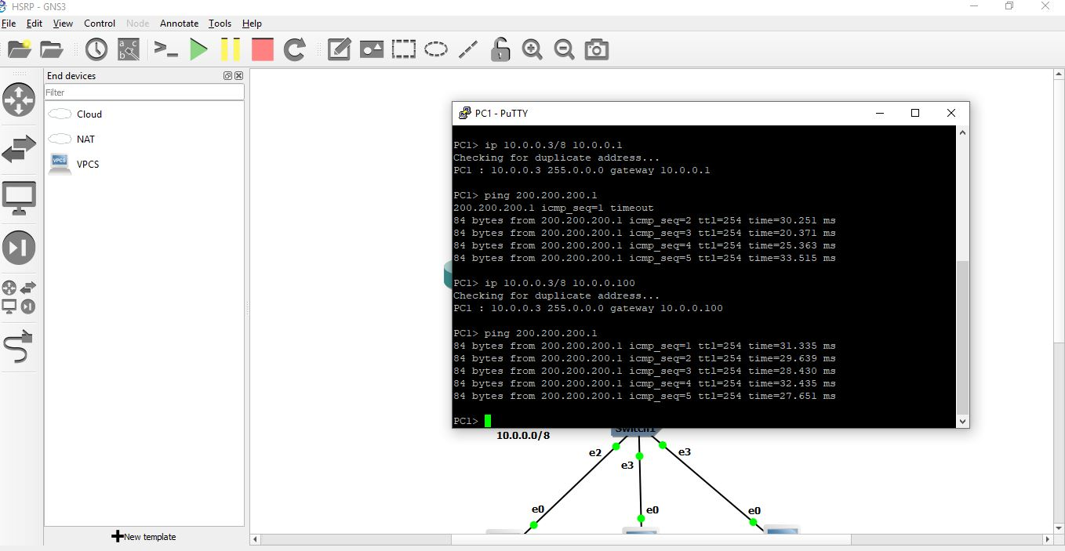
Ping

Slide 21
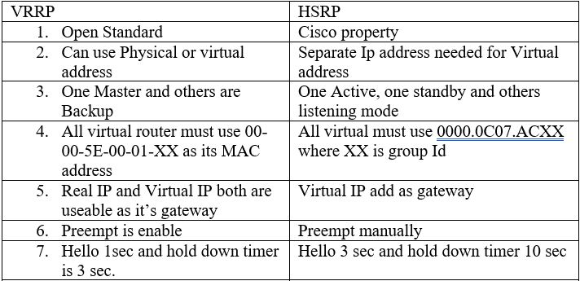

Slide 22
Which one Is Better
Both protocols are efficient. It depends which devices we are using
According to few sources VRRP is Better
Reasons :
VRRP Hello time is 1sec
Preempt automatically enable
It’s Open standard
Any backup can perform as Master when primary device fail to connect

